Slide 1
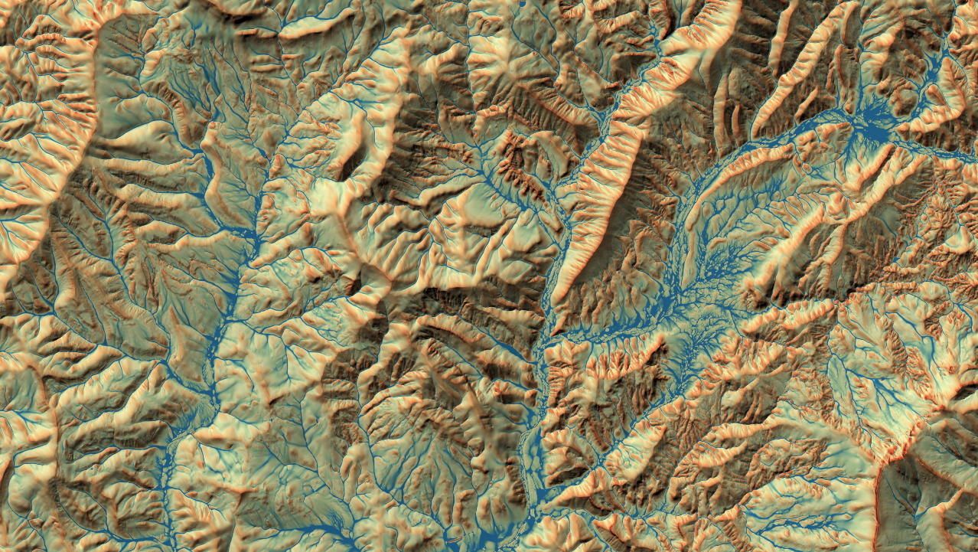





QGIS for Hydrological Applications
Dr. Hans van der Kwast
IHE Delft Institute for Water Education / QWAST-GIS
@hansvanderkwast
@hansakwast

Slide 2
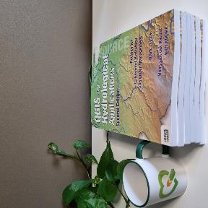


Hans van der Kwast
Physical Geographer, Associate Professor of Open Science and Digital Innovation at IHE Delft
MSc, PhD at Utrecht University, the Netherlands
Researcher at the Flemish Institute for Technological Research (VITO, Belgium)
Board member of Dutch QGIS User Group, OSGeo Charter member
Owner of QWAST-GIS and member of QCooperative
Co-author of QGIS for Hydrological Applications with Kurt Menke (Septima)
GIS OpenCourseWare
Point Cloud Processing and 3D Visualization with QGIS at Udemy
@hansakwast
@hansvanderkwast
@hansvanderkwast

Slide 3
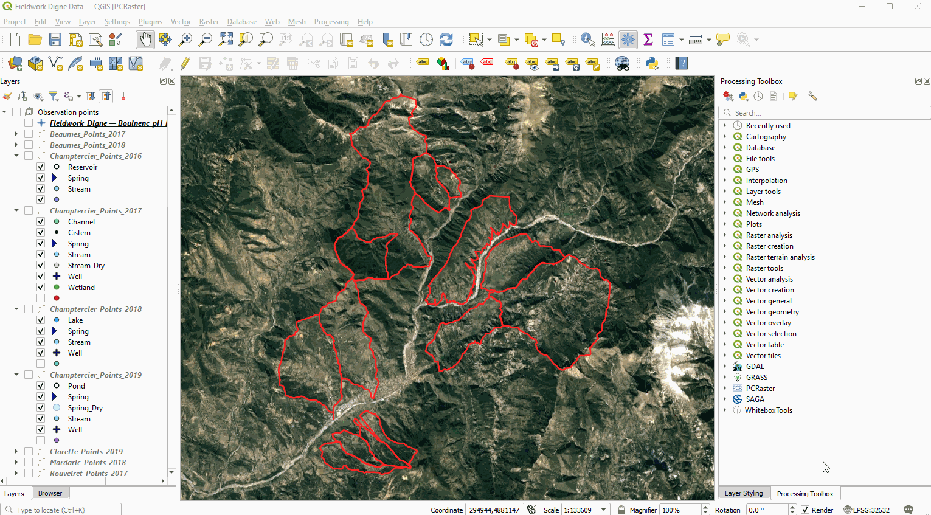
QGIS as integrator of tools

Slide 4
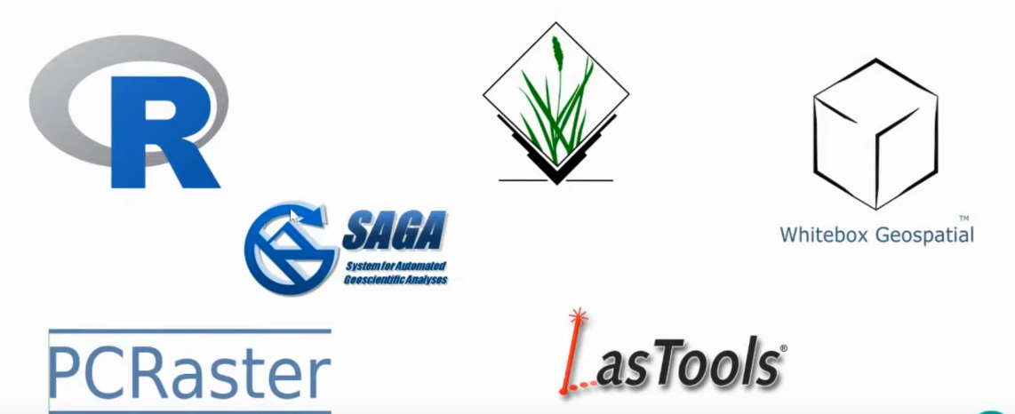
Processing Provider Plugins

Slide 5
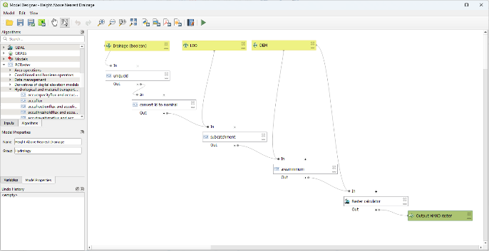
Processing Provider Plugins
Add new algorithms (tools) to the Processing Toolbox of QGIS
Can be used in the model builder (graphical models)
Batch processing
Python classes
Can also add menus

Slide 6
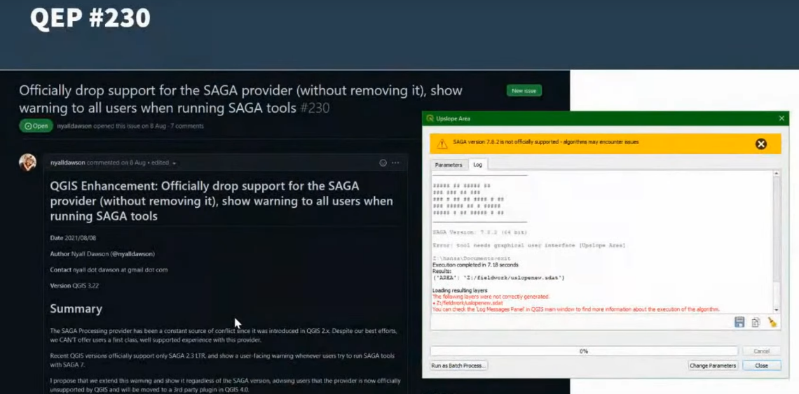
Processing Provider Plugins

Slide 7
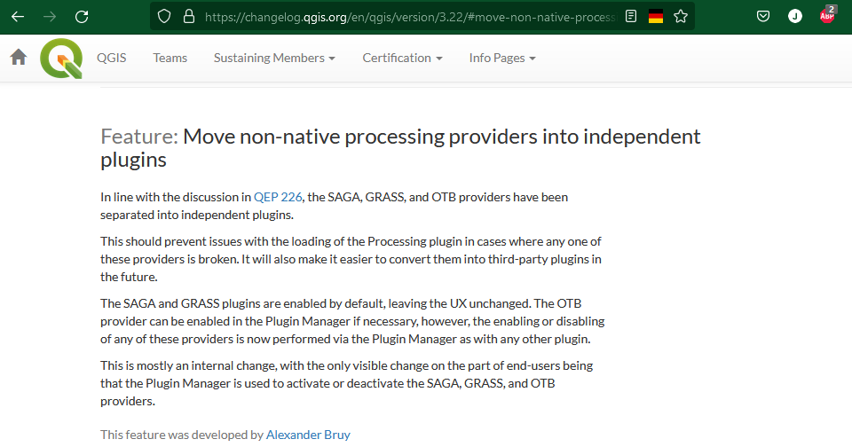
Processing Provider Plugins

Slide 8
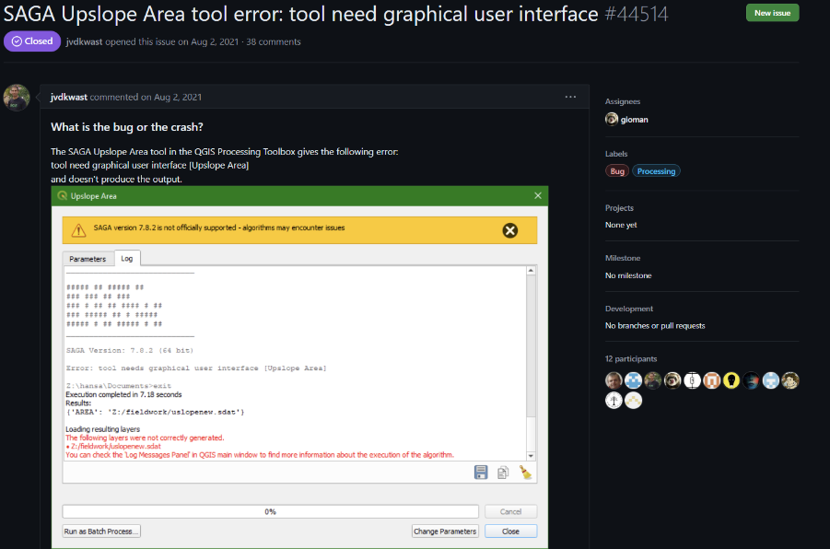
SAGA in QGIS Issue

Slide 9
PCRaster
PCRaster is a powerful software package designed for dynamic environmental modeling, supporting distributed simulation models.
Stochastic modelling & data assimilation.
It's widely used in various environmental fields such as geography, hydrology, and ecology.
Offers around 100 optimized functions for spatio-temporal modeling, supports Python for model building, and includes multicore CPU support for operations.
Visualization and Extensions: Provides the Aguila program for visualizing uncertain spatio-temporal data and extensions like PCRaster Modflow for groundwater modeling.
pcraster.geo.uu.nl

Slide 10
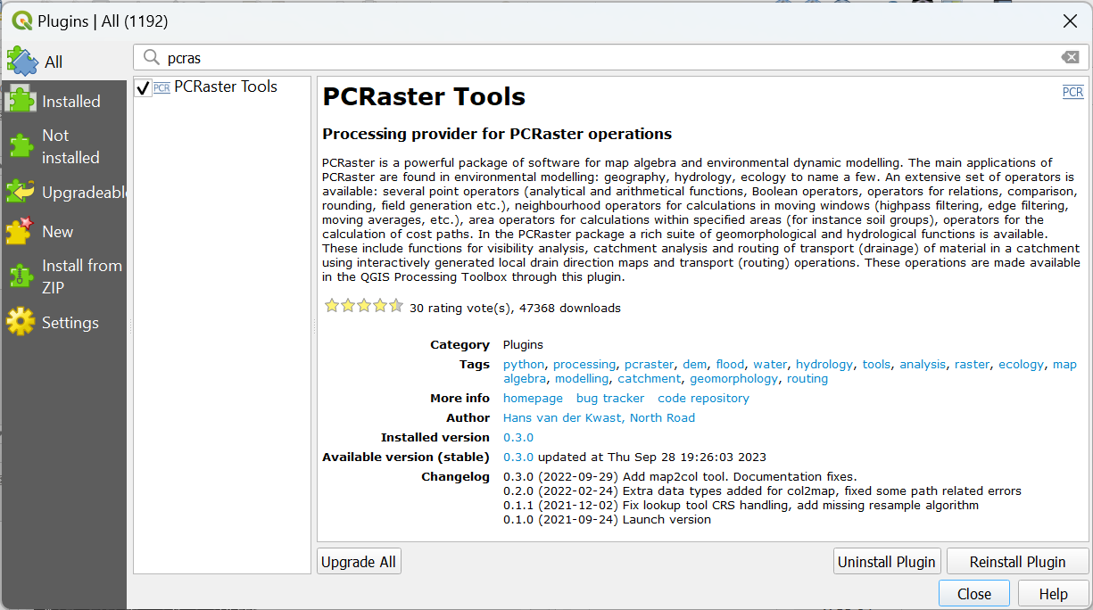
The PCRaster Tools plugin
2020 – 2021: Prototype with scripts via the Resource Sharing plugin. Worked only in a Conda environment
Developed as plugin together with Nyall Dawson (North Road)
24 September 2021: Launch
>45k times downloaded
2022: used in chapter 4 of the book QGIS for Hydrological Applications – 2nd Edition
Easy install on windows with the OSGeo4W installer, thanks to Jürgen Fischer
Works great on Conda for all operating systems

Slide 11
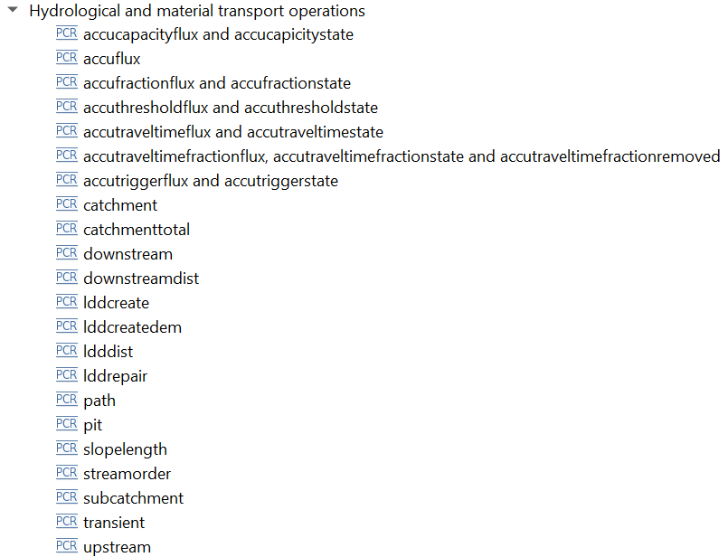
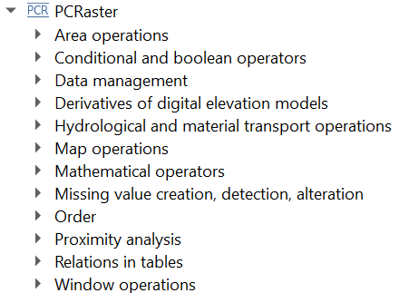
Tools
Based on PCRaster Python functions

Slide 12
Stream and catchment delineation
Download DEM tiles
Fill sinks / remove spikes
Calculate the flow direction map
Derive catchment
Mosaic DEM tiles
Burn-in the stream network
Define outflow point
Reproject DEM
Subset DEM
Interpolate voids
Derive streams
Convert dataset to model format

Slide 13
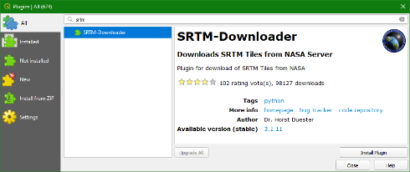
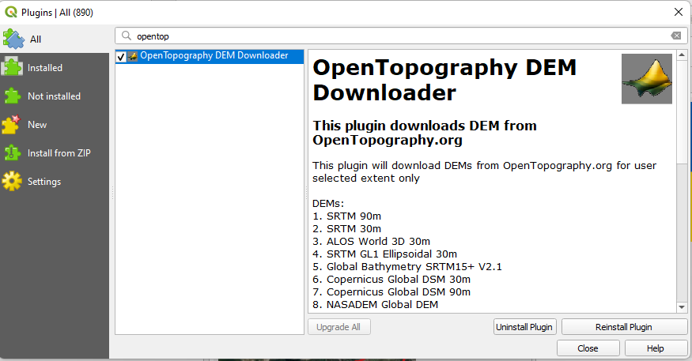
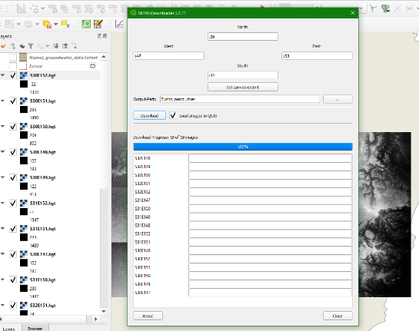
DEM Open Data

Slide 14
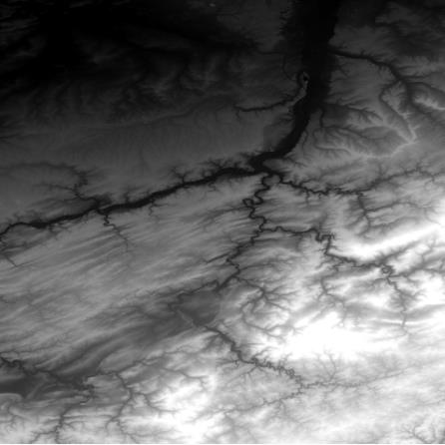
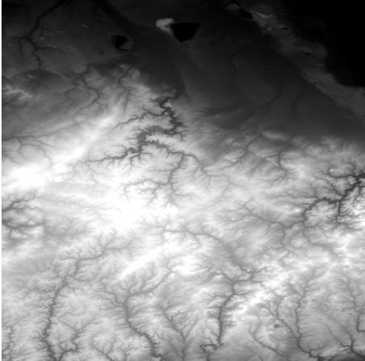
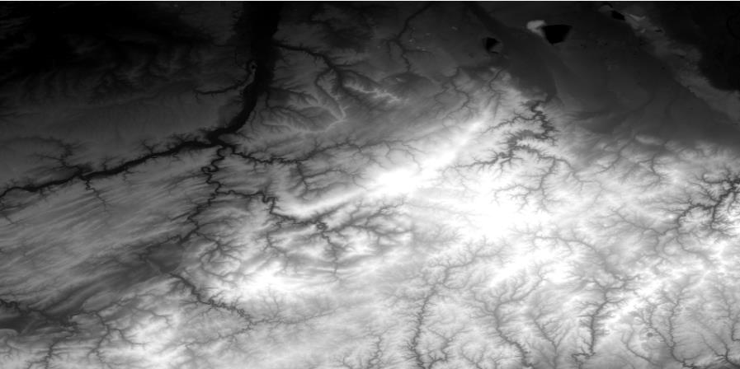
Mosaic DEM tiles

Slide 15
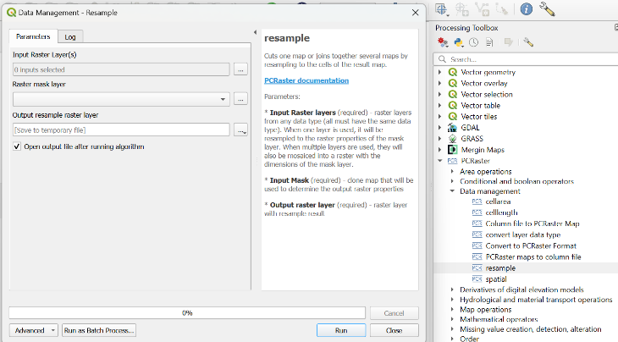
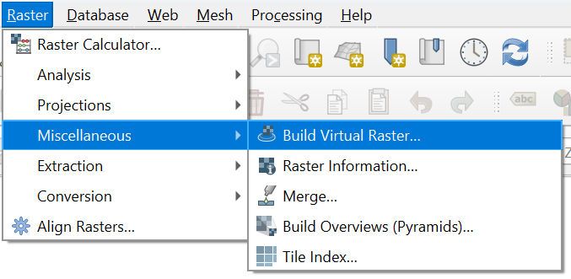
Mosaic tools
QGIS Core
PCRaster Tools plugin

Slide 16
Reproject DEM
Global datasets are usually in EPSG:4326 (Geographic Coordinate System, Lat/Lon)
For correct calculation of DEM derivatives, the DEM should be reprojected to a Coordinate Reference System

Slide 17
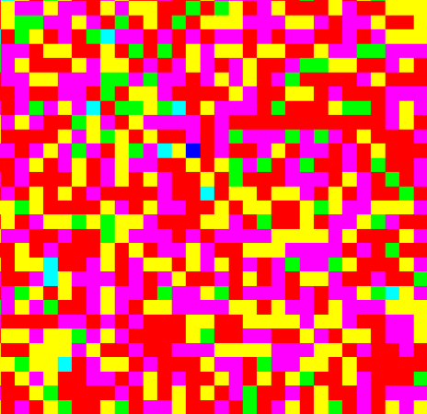
Calculation of slope
slope = arctan(Δz/ Δx)
Moving Window or Kernel (3 x 3)
z
→
→ x
In a grid slope is calculated as a focal operation. The steepest slope in the window is assigned to the cell

Slide 18
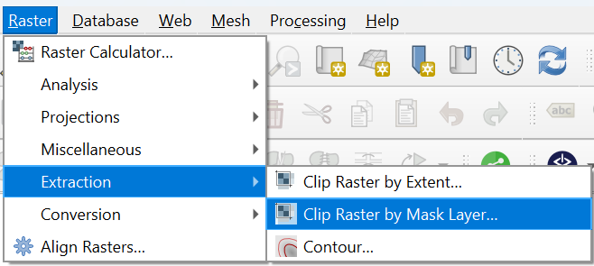
Subset DEM
DEM too large: calculation times for the following steps can become too large or computer runs out of memory
DEM too small: catchment boundaries are cut off
QGIS Core

Slide 19
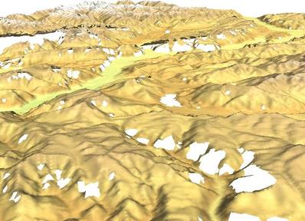
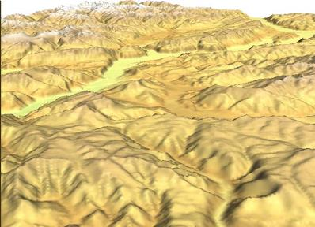
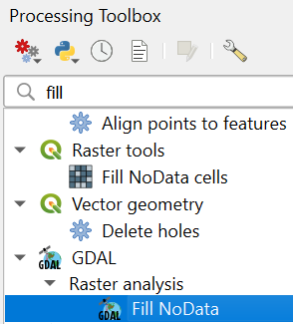
Interpolate voids
Voids are pixels with NODATA in your DEM as a result of the acquisition procedure
Voids can be interpolated using the values of surrounding cells
Source: Markus Neteler
QGIS Core

Slide 20
Fill sinks
DEM creation results in artificial pits in the landscape
A pit is a set of one or more cells which has no downstream cells around it
Pits are removed using the fill sinks function in GIS software
If landscape contains real sinks (e.g. lakes), these need to be added after pit removal
Water trapped in a pit
 | 3 | 5 | 7
 | 6 | 2 | 3
 | 9 | 9 | 9

Slide 21
Fill sinks
Flow direction
Pits can be removed by:
Filling up
Cutting through

Slide 22
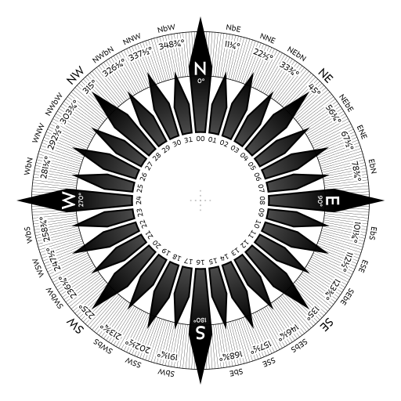
Flow Direction
0 – 360 degrees
> 8 bit needed
Only 8 discrete directions used → D8 or Single Flow Direction (SFD)
Tools use different encodings!
D8 flow pointer raster
ArcGIS
PCRaster
SAGA
GRASS
32 | 64 | 128
16 | -1 | 1
8 | 4 | 2
7 | 8 | 9
4 | 5 | 6
1 | 2 | 3
7 | 0 | 1
6 | 255 | 2
5 | 4 | 3
3 | 2 | 1
4 | NULL | 8
5 | 6 | 7

Slide 23
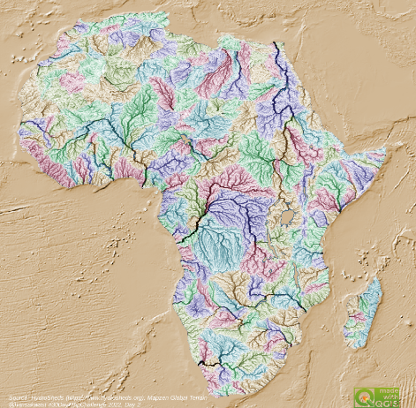
Different flow direction algorithms
D8 Algorithm:
Assigns flow from each pixel to one of eight neighbours.
Simplifies flow, leading to errors in hillslope areas.
D-Infinity (Dinf) Algorithm:
Addresses D8’s limitations on divergent hillslopes.
Multiple flow direction algorithm, partitioning flow between one or two neighbours.
Handles ambiguous topography, minimizes over-dispersion.
Single Flow Direction (SFD):
Flow is directed to a single downstream neighbour.
Effective in convergent landscapes like channels.
Multiple Flow Directions (MFD):
Allows flow partitioning across multiple neighbours.
Better represents divergent flow on hillslopes.

Slide 24
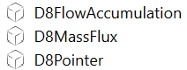
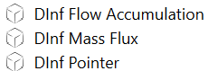
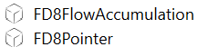
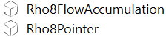
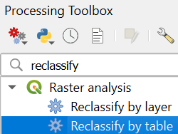
Which tools for flow direction?
WhiteboxTools has most options and for different pointer rasters
If the workflow uses different processing provider tools, you need to reclassify the flow direction before using it in the next tool!
WhiteboxTools
QGIS Core

Slide 25
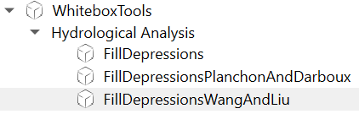
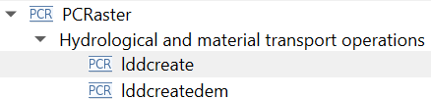
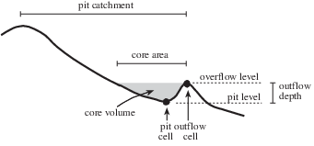
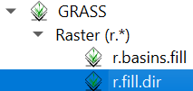
Fill sinks algorithms
SAGA & WhiteboxTools
Planchon & Darboux
Wang & Liu
PCRaster
lddcreate
lddcreatedem
GRASS
Jenson & Domingue
Source: PCRaster

Slide 26
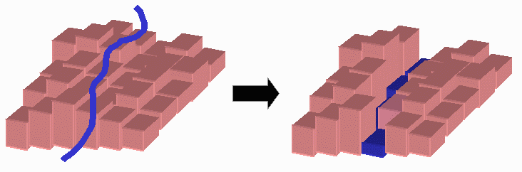
Burn-in the stream network
When a river network layer exists it can be used to force the flow direction algorithm to follow the river network
Source: Brad Hudgens (1999)

Slide 27
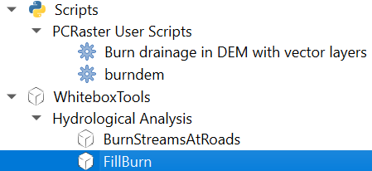

Tools for burning

Slide 28
From Flow Direction to Stream Link
D8 for each cell
Stream link

Slide 29
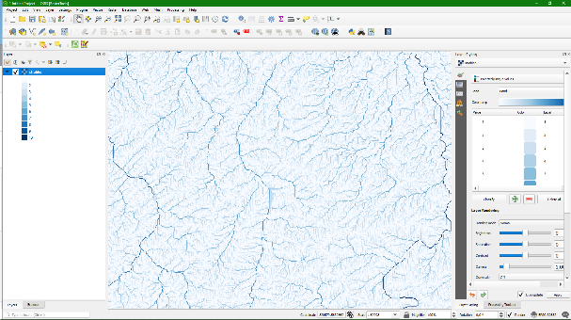
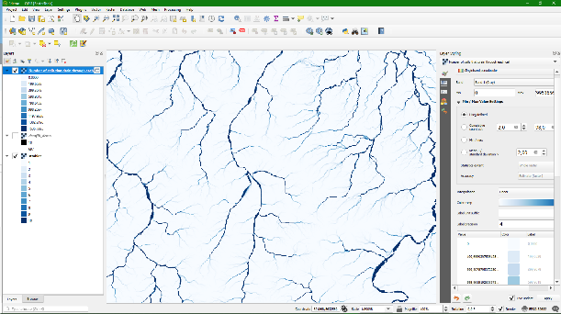
Delineate streams
Calibrate Strahler orders
Calibrate flow accumulation

Slide 30
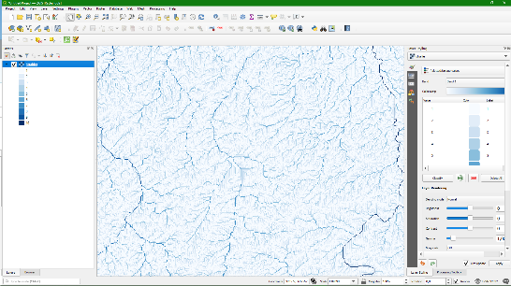
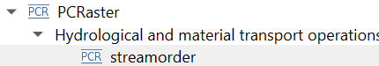
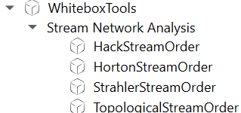
Strahler Order Method
1
1
1
1
2
1
2
2
2
1
3
1
1
1
3
3
4
1
4

Slide 31
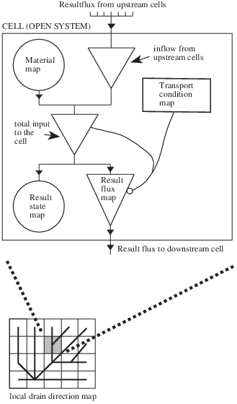
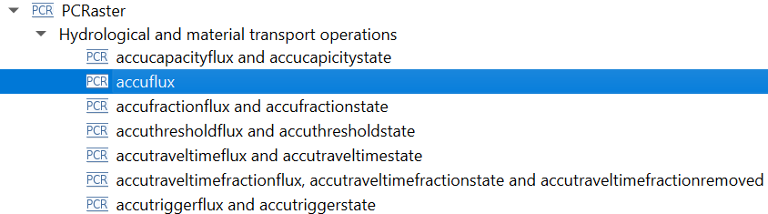
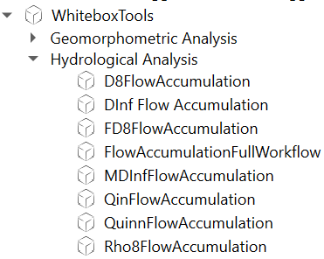
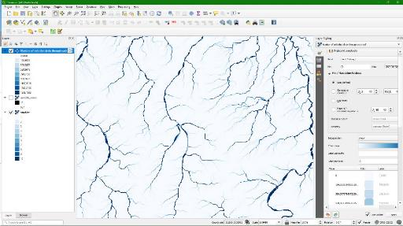
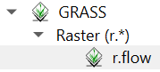
Flow Accumulation Method
Source: PCRaster

Slide 32
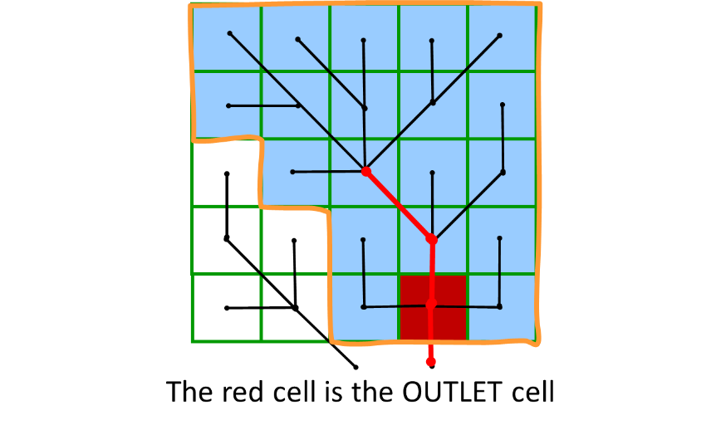
Define Outflow Point
Outlet
Pour Point
Outflow
Need to snap to delineated stream!

Slide 33
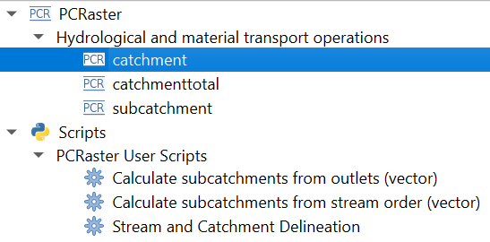
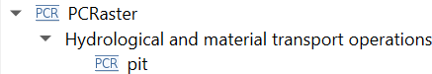



Tools for Outflow Point and (Sub)Catchment
Find all depressions
Delineate (sub)catchments
Snap to model

Slide 34

Graphical Modeler

Slide 35


More tools and models
Resource sharing plugin
Plan to have an easier repo linked with the plugin
Add dynamic models to QGIS

Slide 36



Visualisation of Flow Direction

Slide 37


Raster Animation

Slide 38


QGISHydro Book Fund
By purchasing the book you support students from the Global South to join FOSS4G and QGIS events!

Slide 39


https://courses.gisopencourseware.org/

